Slide 1
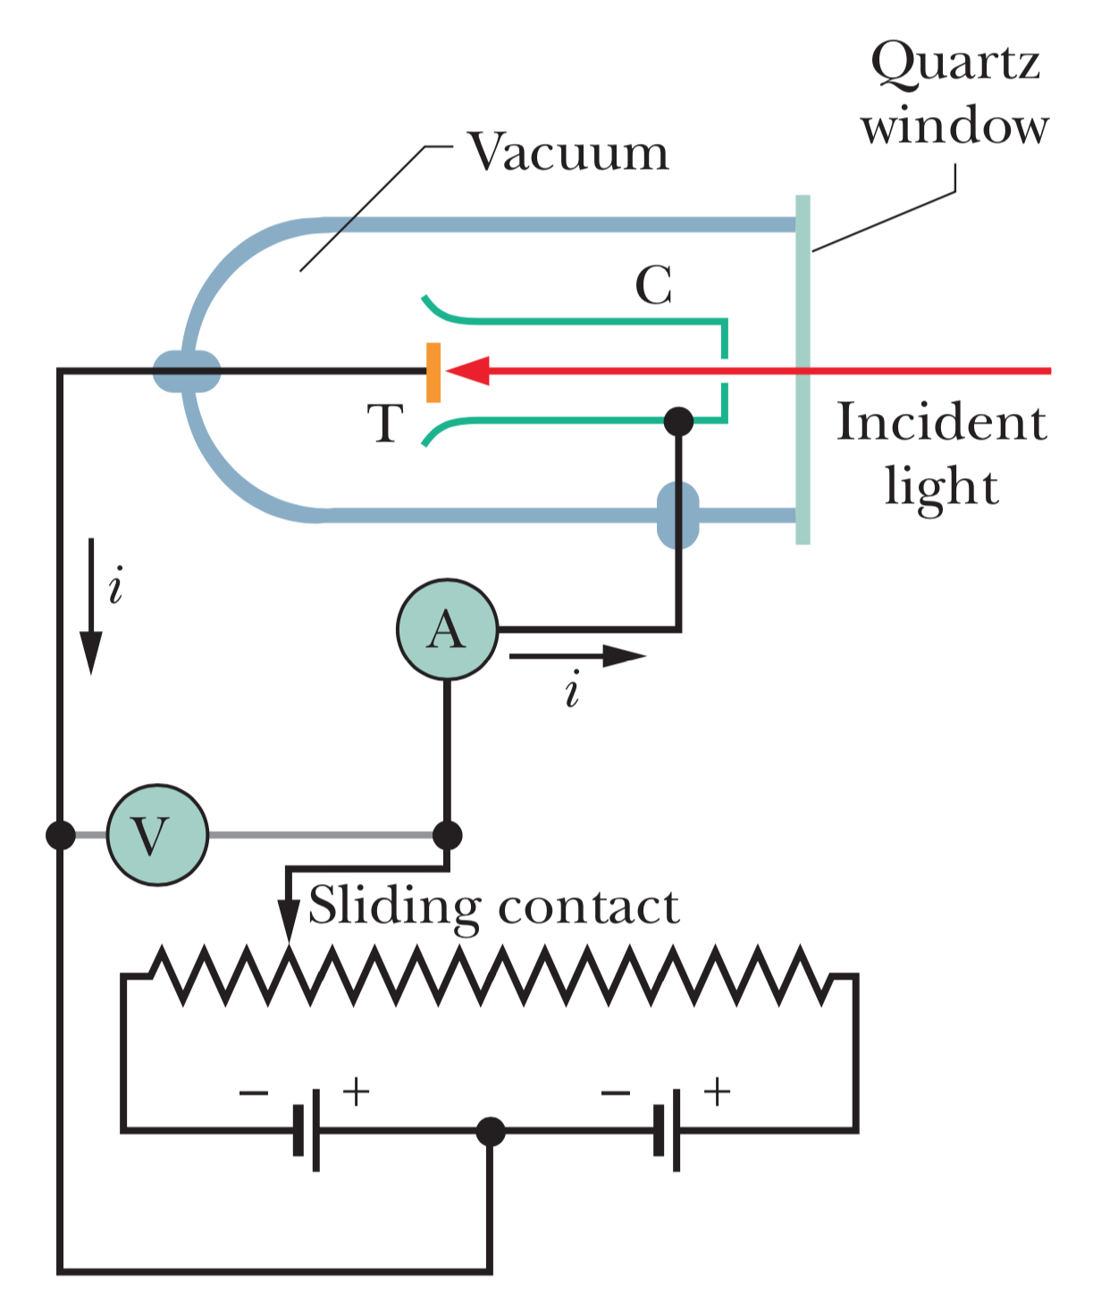
Photoelectric experiment

Slide 2
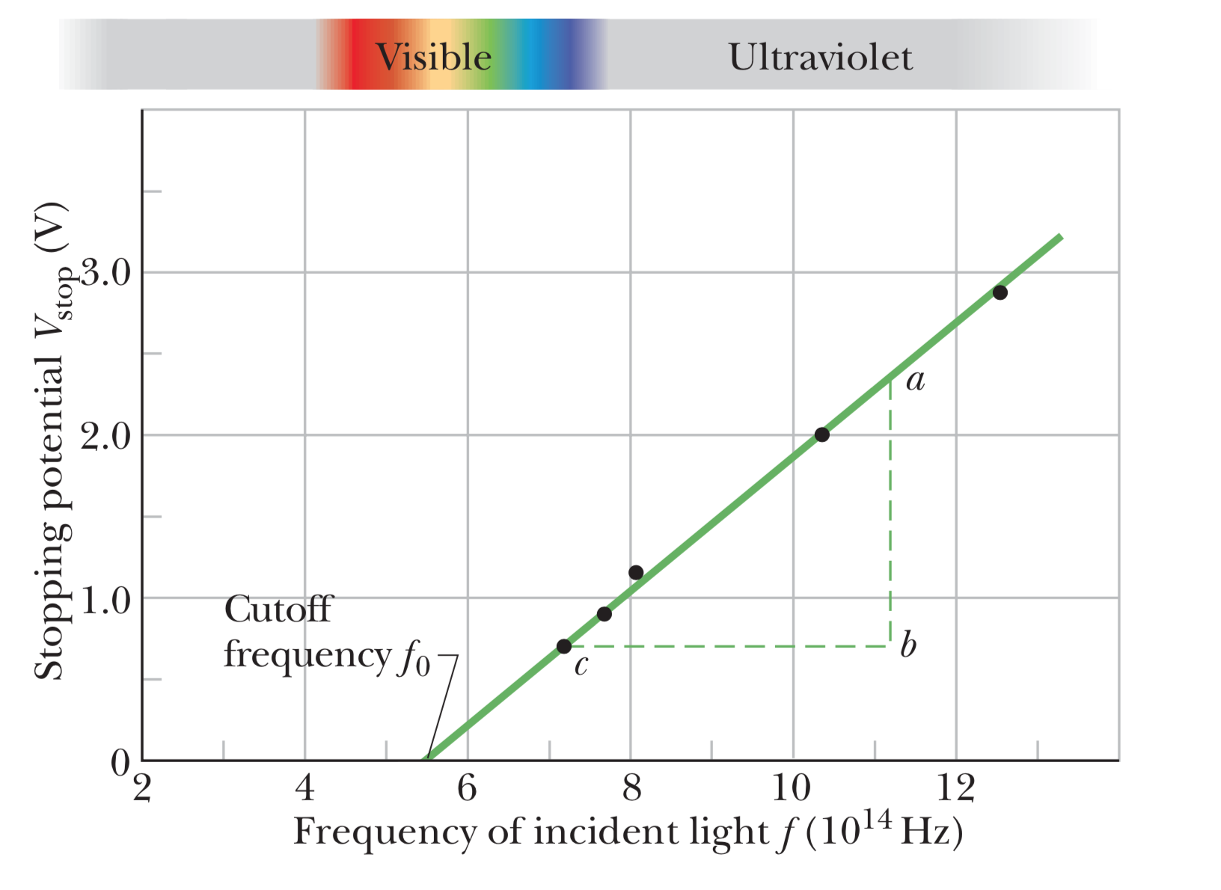
Stopping potential vs. incident light frequency

Slide 3
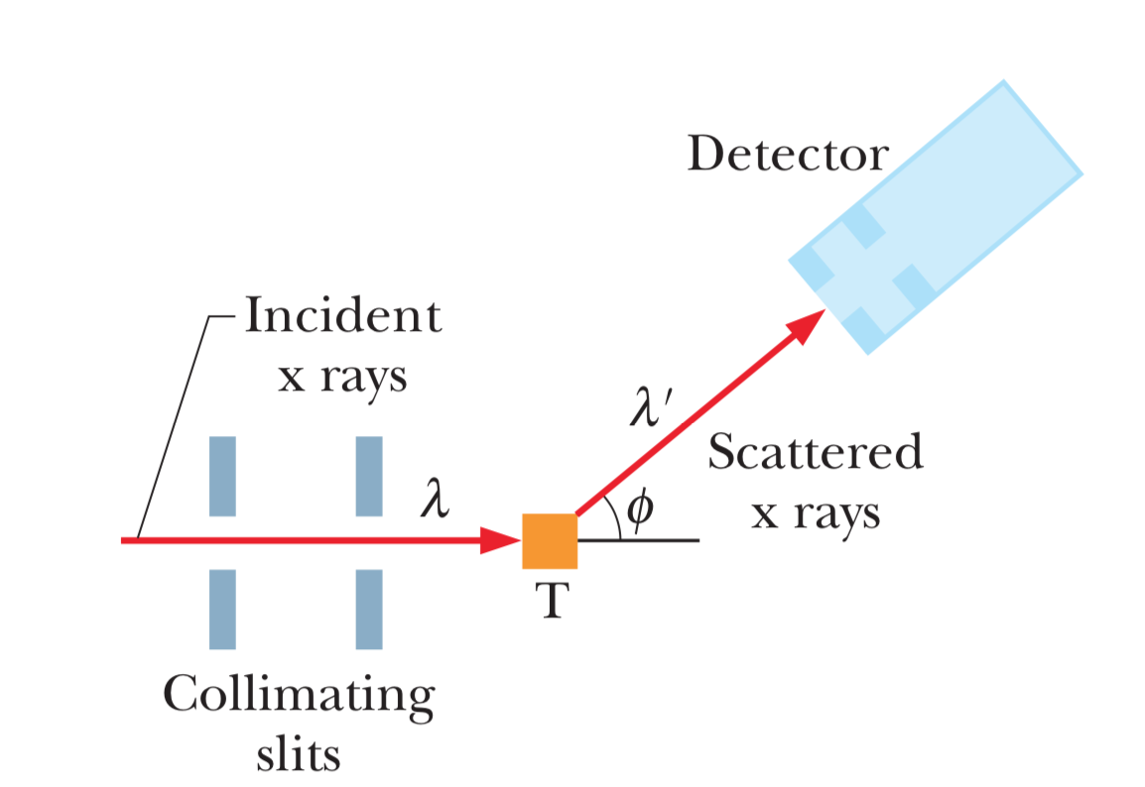
Compton experiment

Slide 4
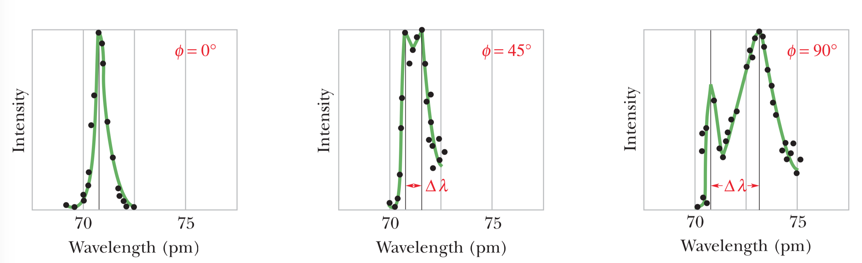
Results of Compton’s experiment
Different scattering angles 𝜙

Slide 5
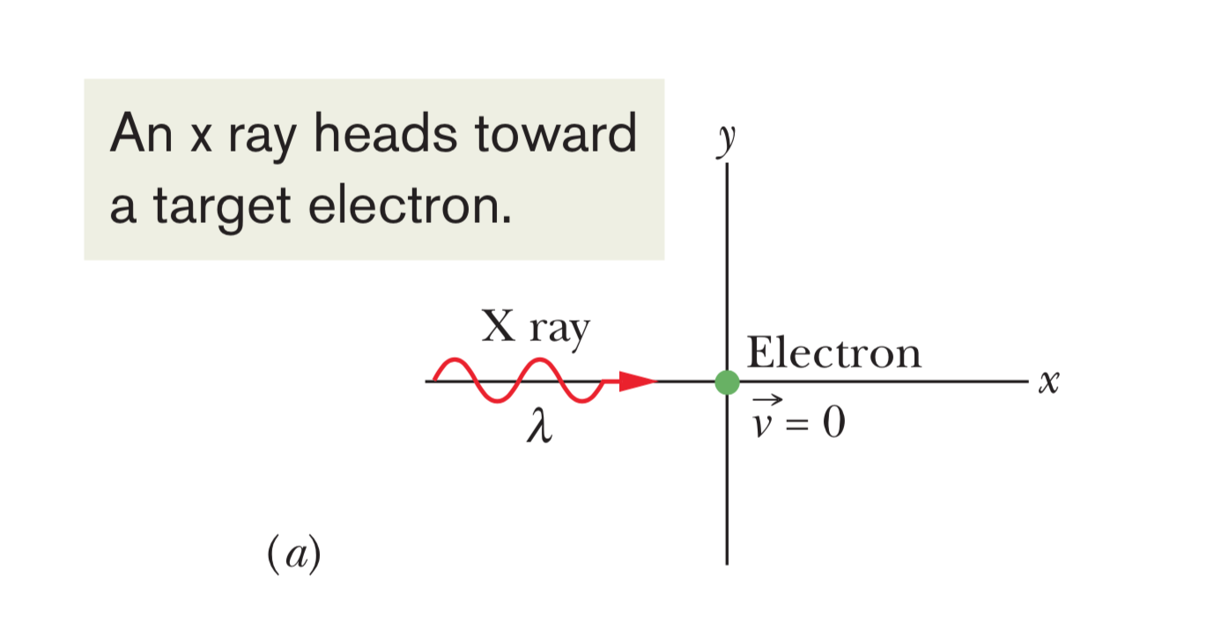
Scattering (1)

Slide 6
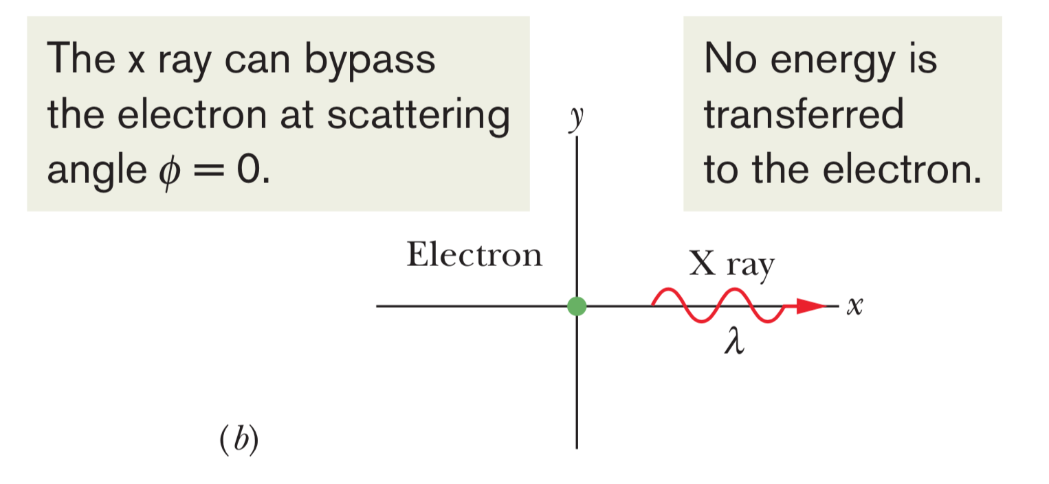
Scattering (2)

Slide 7
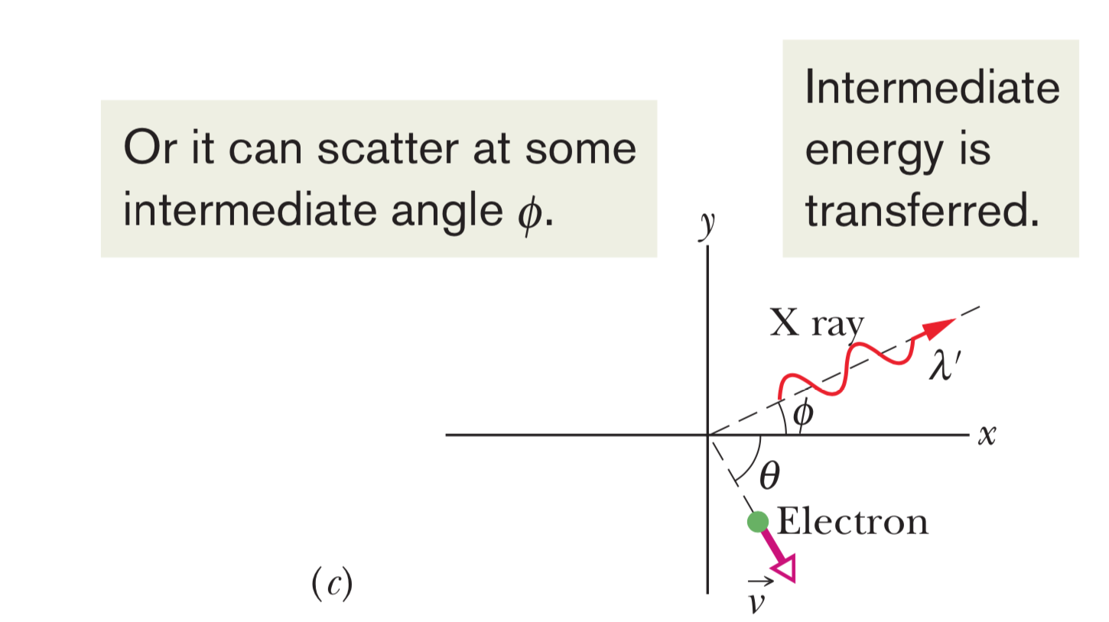
Scattering (3)

Slide 8
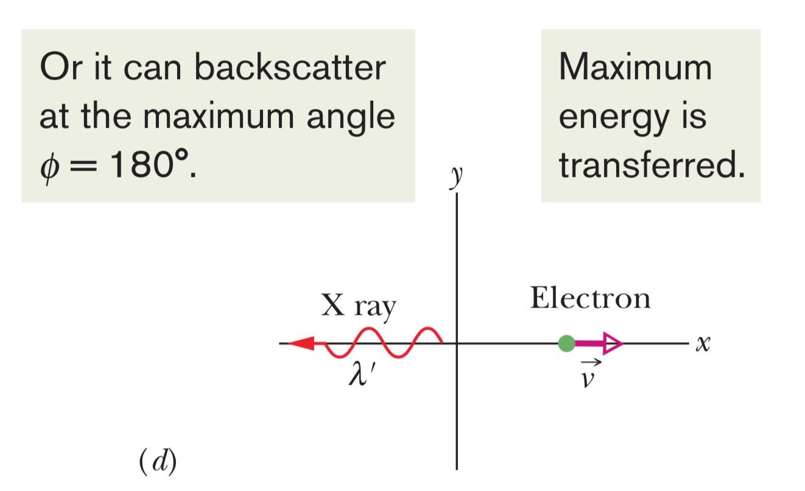
Scattering (4)

