Slide 1
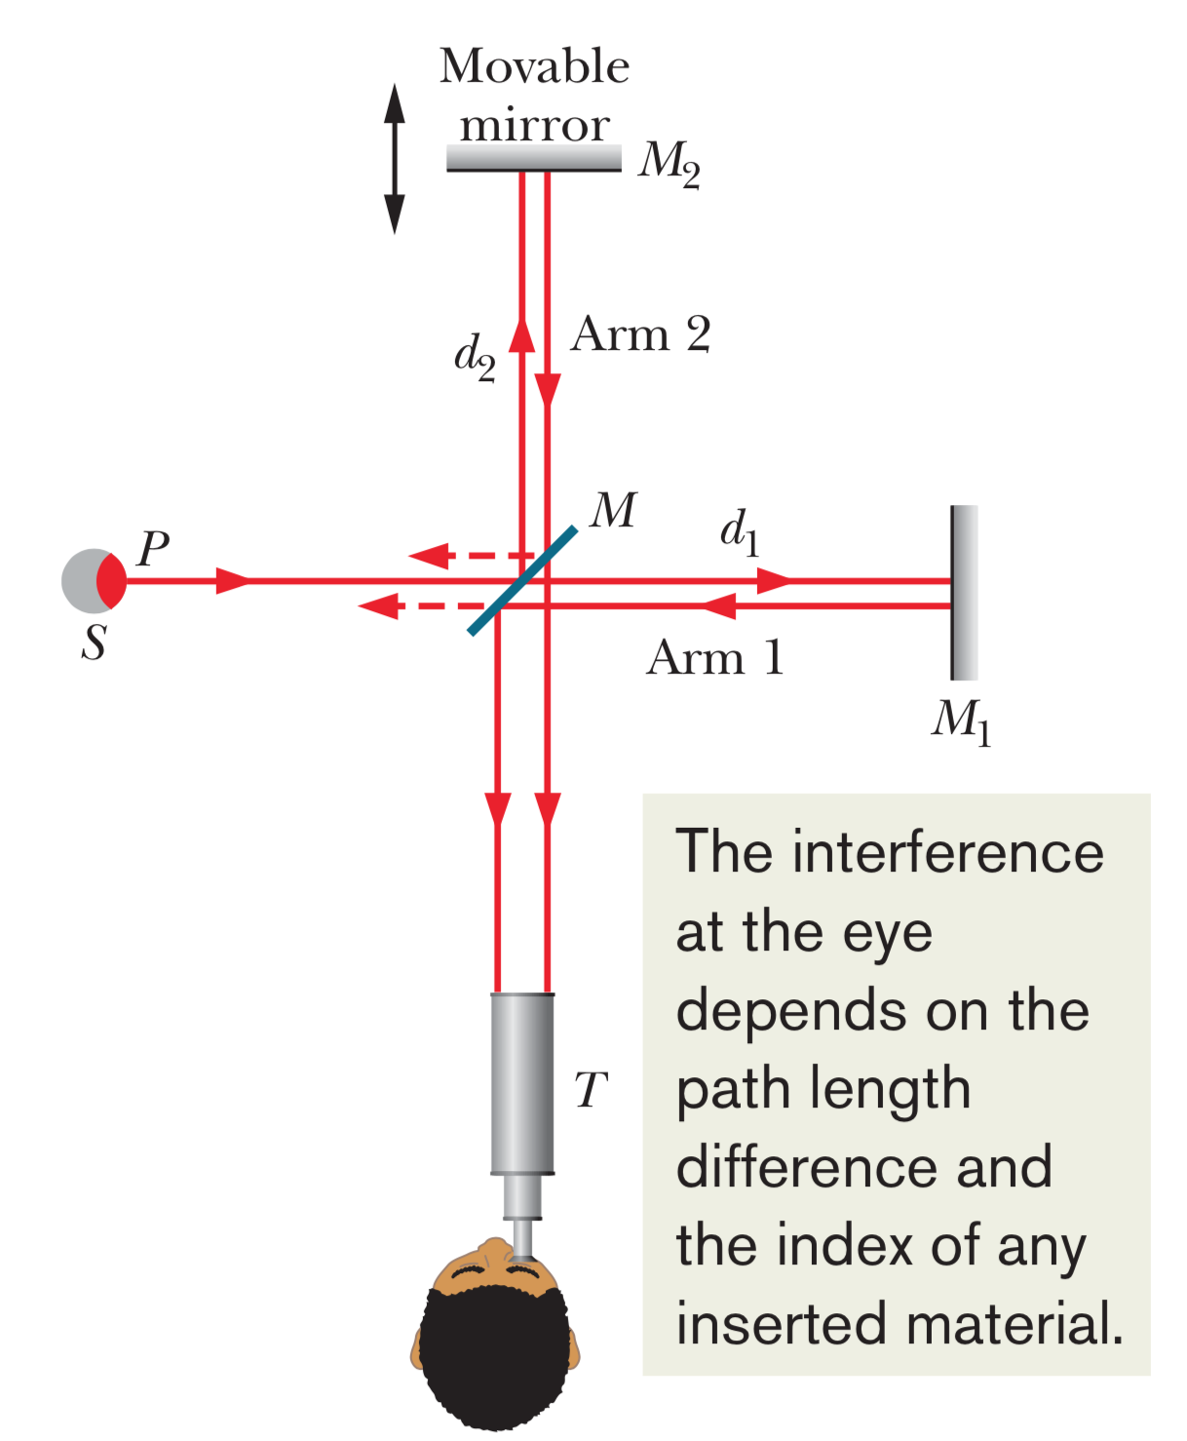
Michelson interferometer

Slide 2
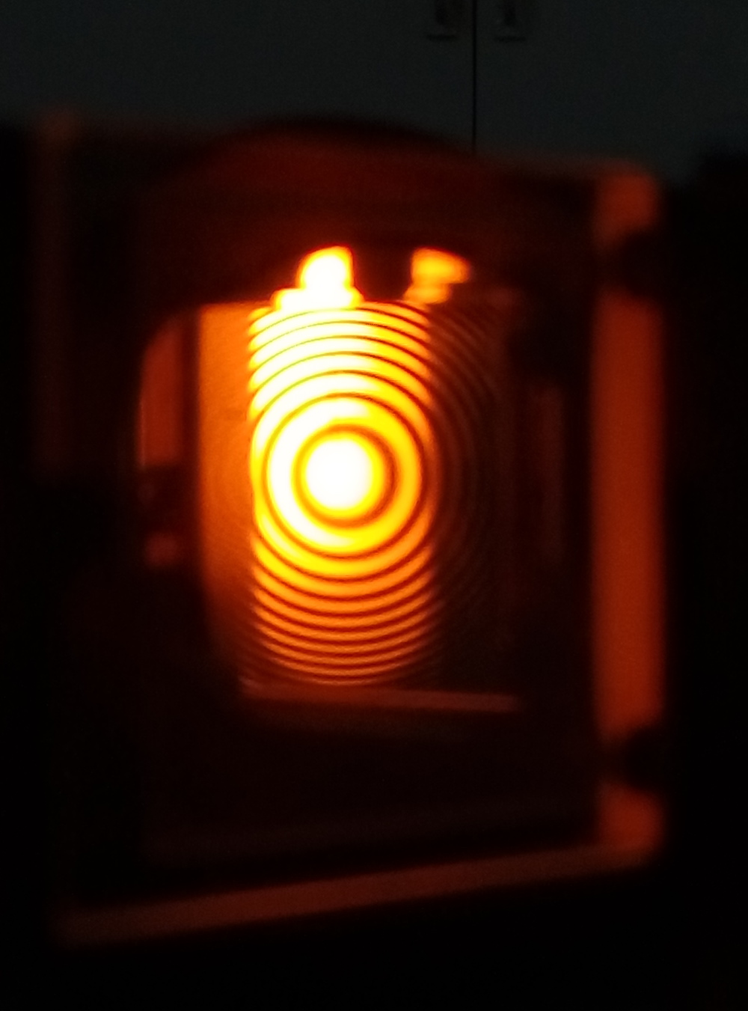
Fringe pattern observed in Michelson int.

Slide 3
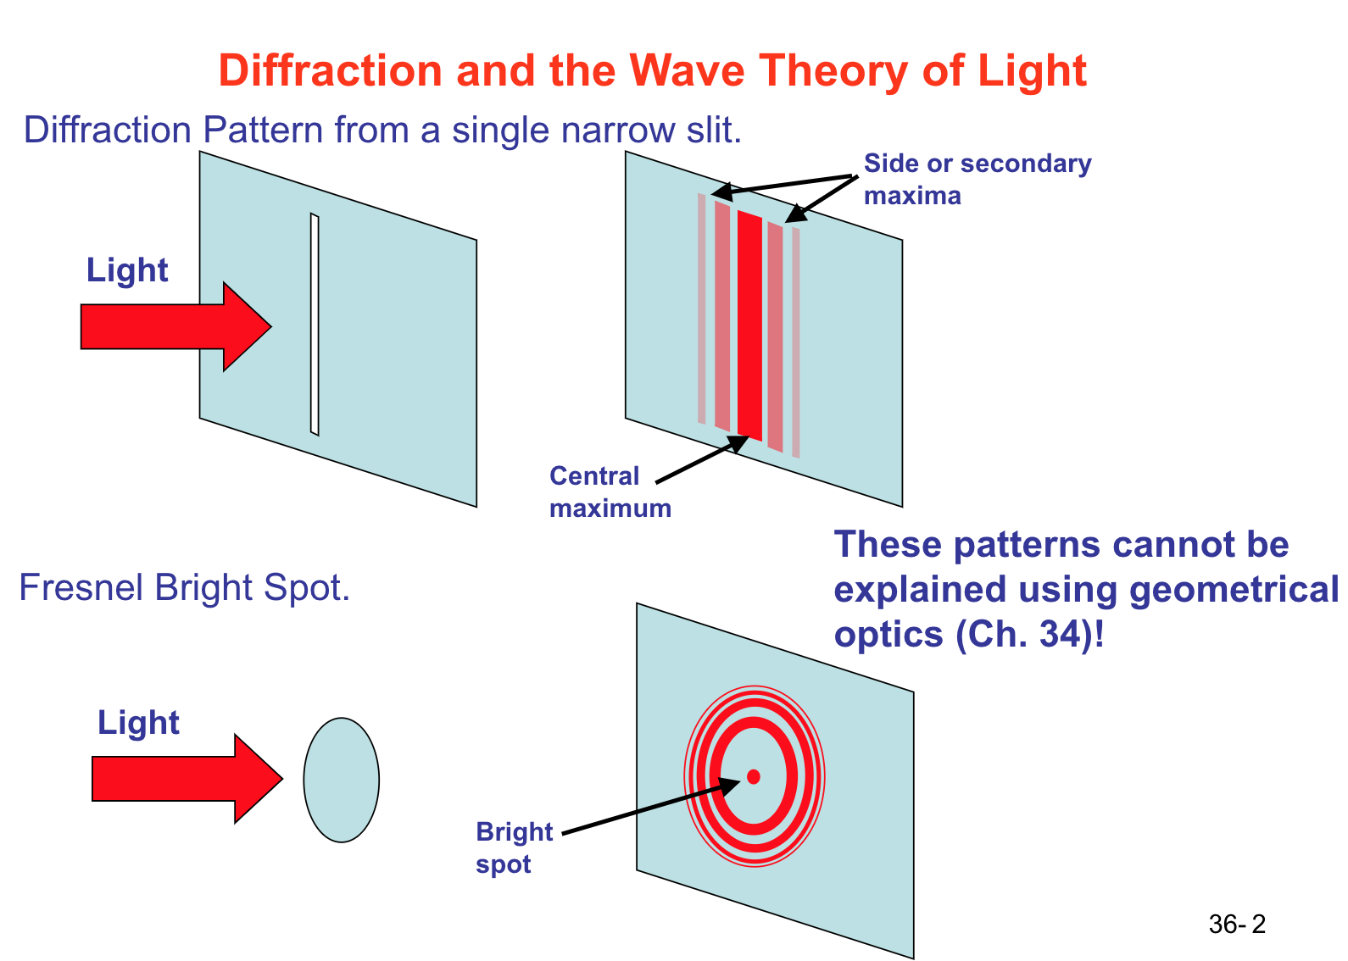
Diffraction

Slide 4
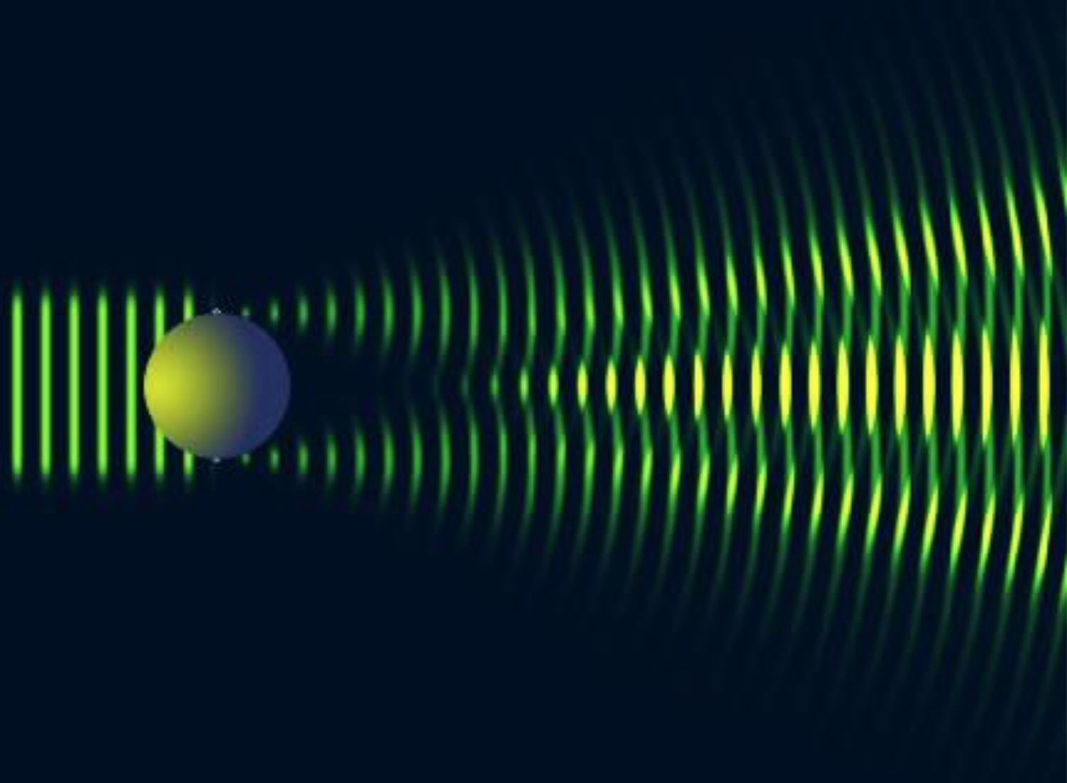
Diffraction (ctd.)
Interference causes bright spot in the middle

Slide 5
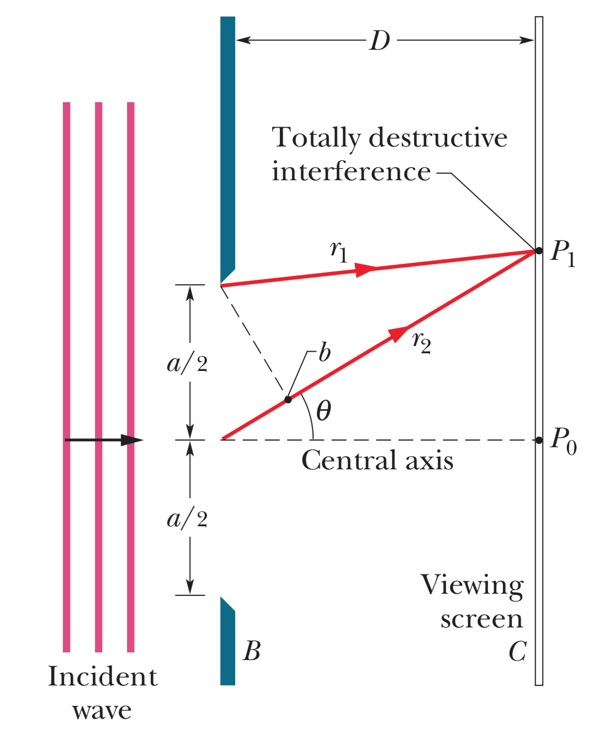
Locating minima from diffraction through a single slit

Slide 6
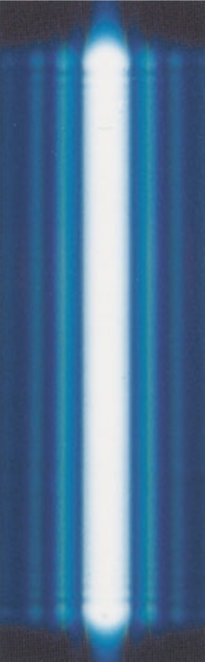
Diffraction pattern observed

Slide 7
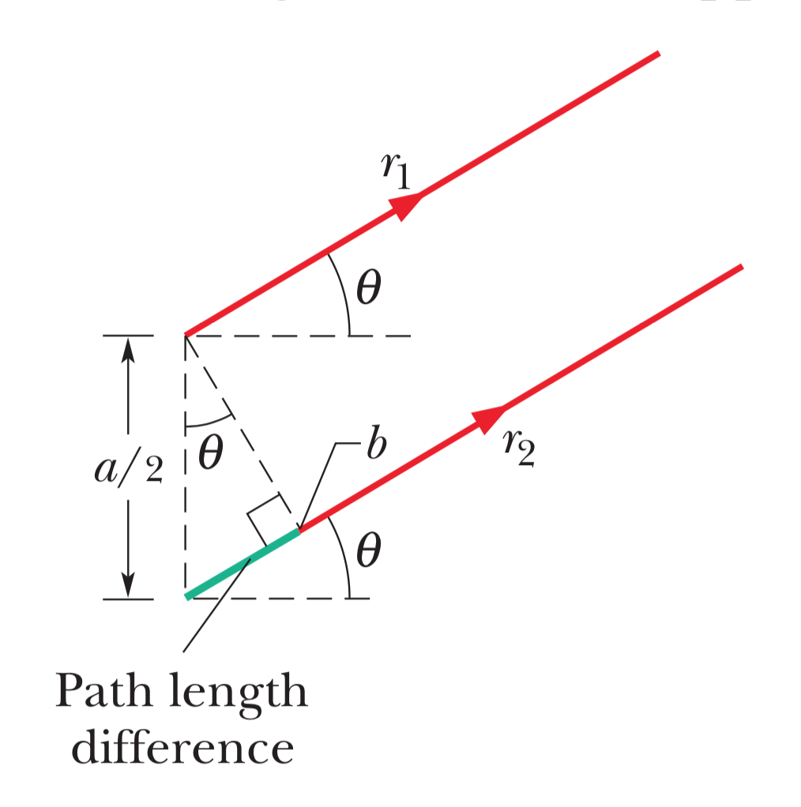
Approximation for locating dark fringes

Slide 8
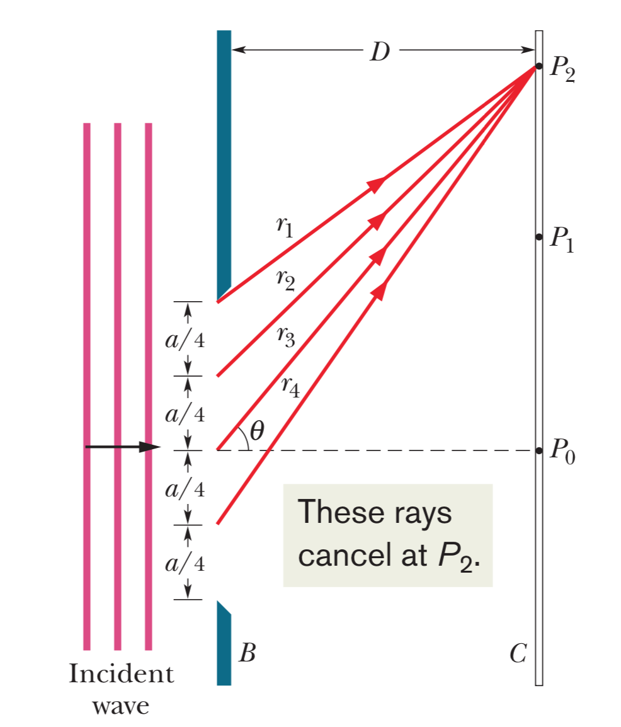
Finding second minima

Slide 9
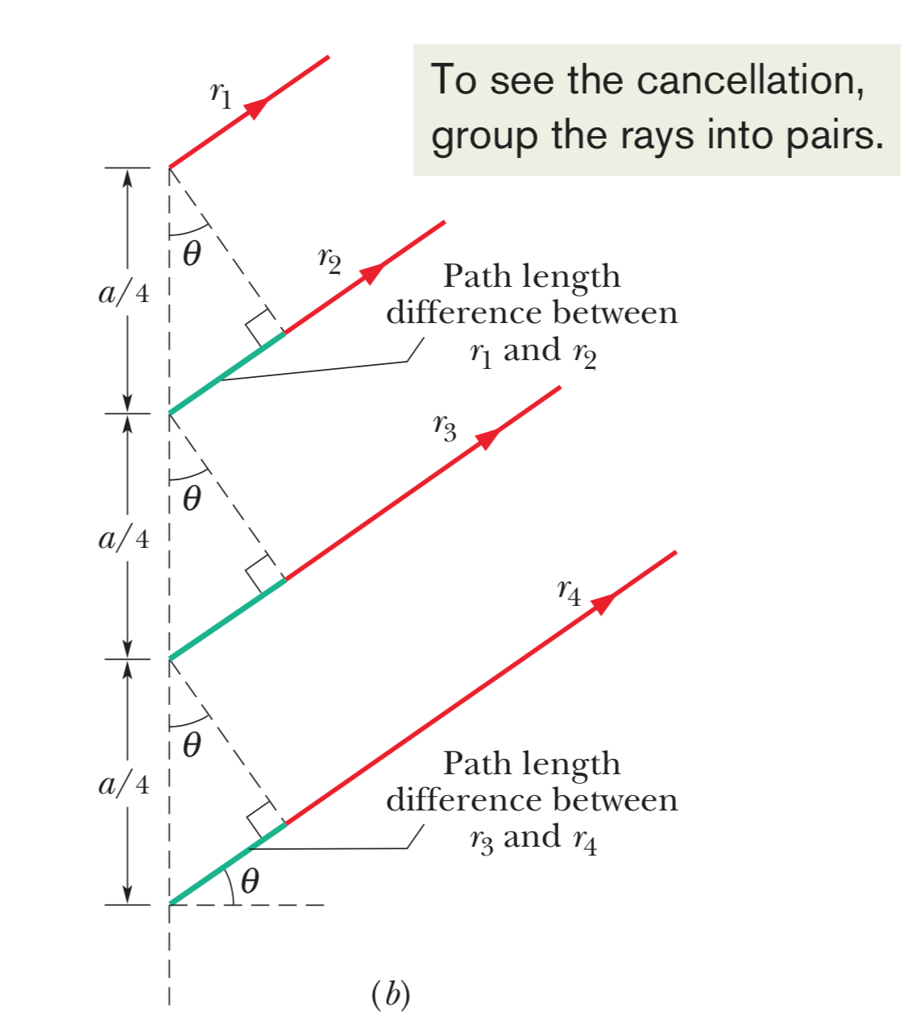
Approximation for locating 2nd dark fringes

