Slide 1
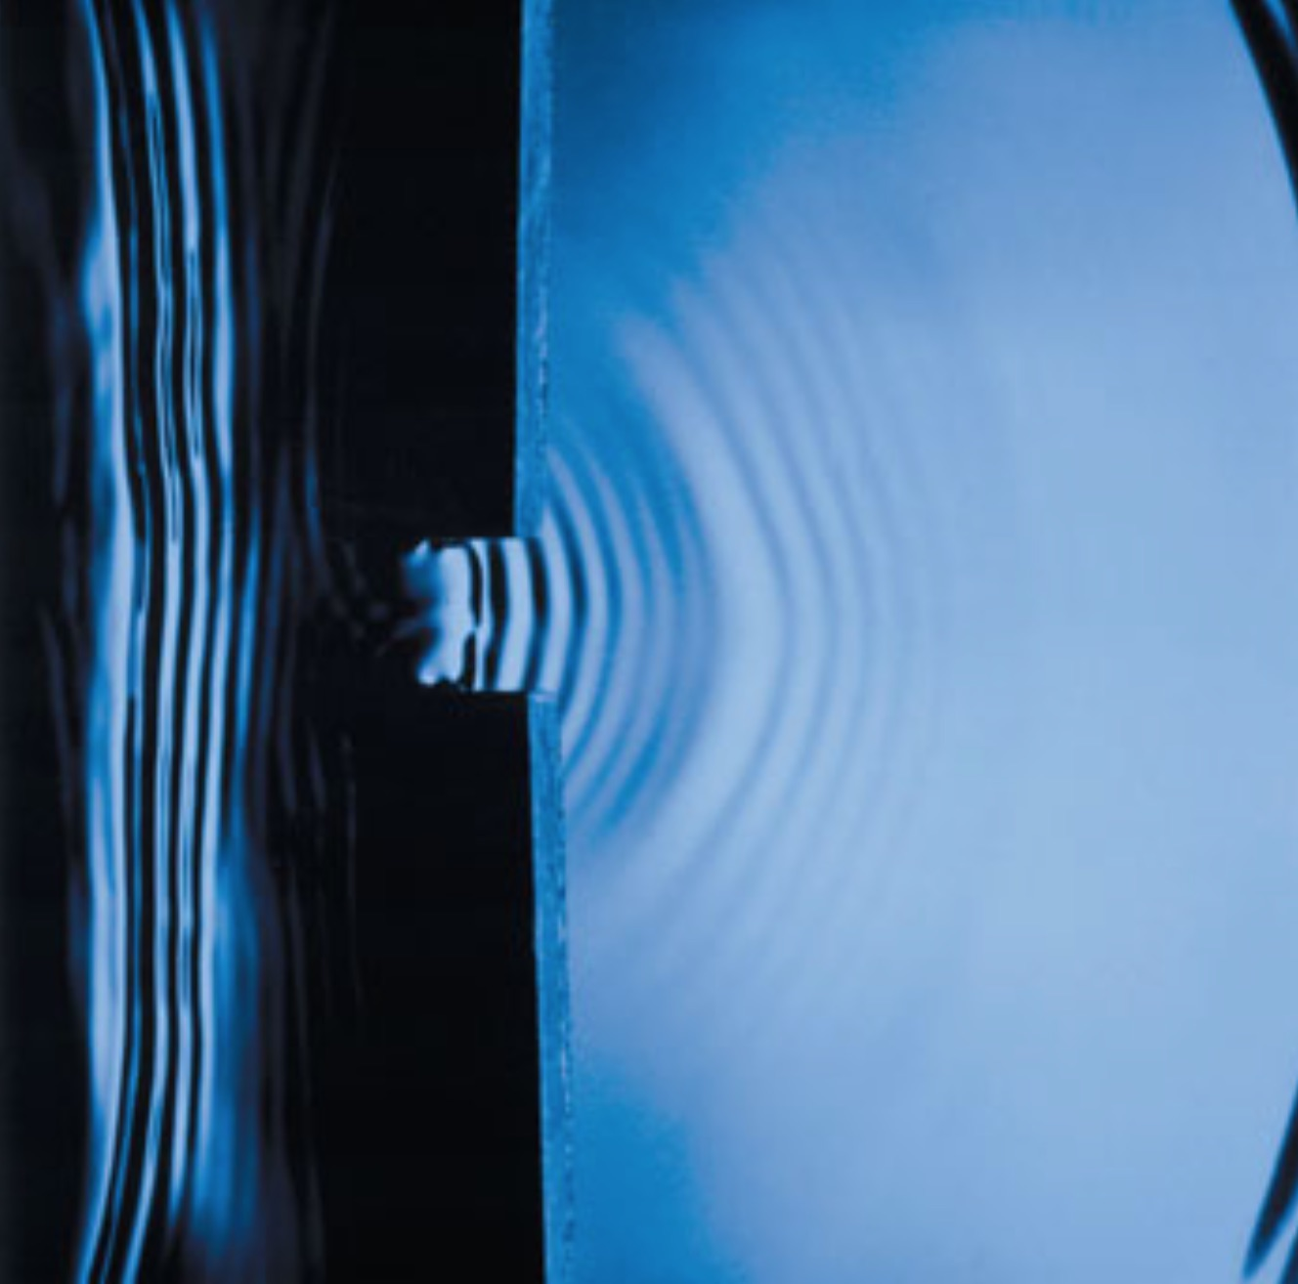
Diffraction of water waves

Slide 2
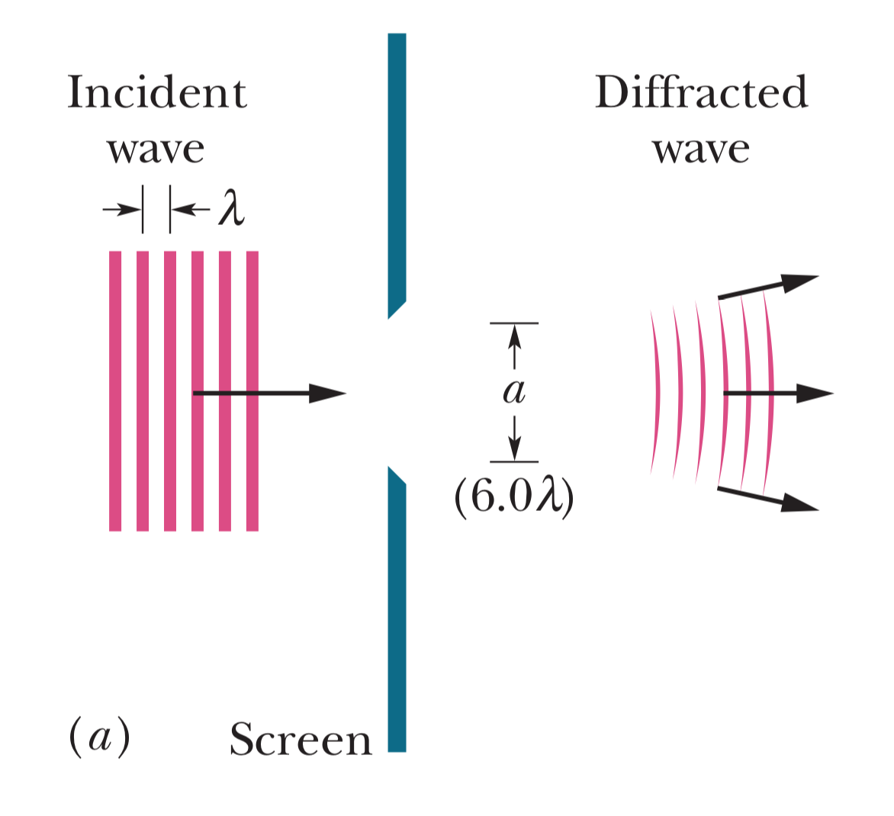
Diffraction of light (1)

Slide 3
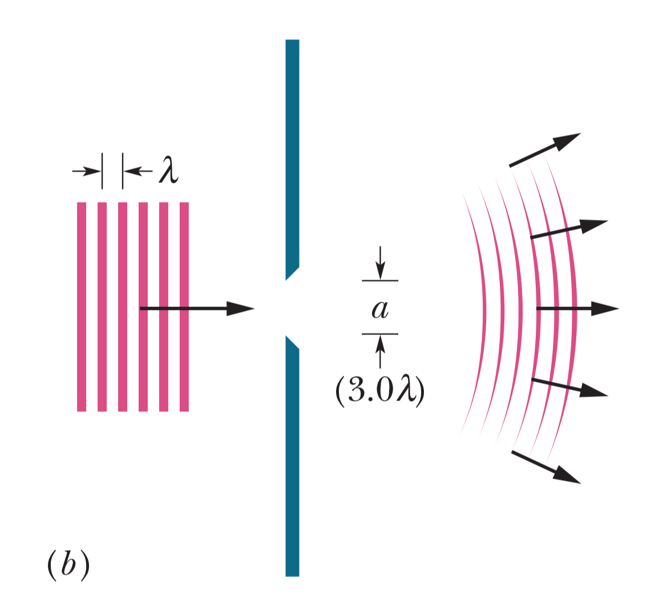
Diffraction of light (2)
Narrower the slit, greater the diffraction

Slide 4
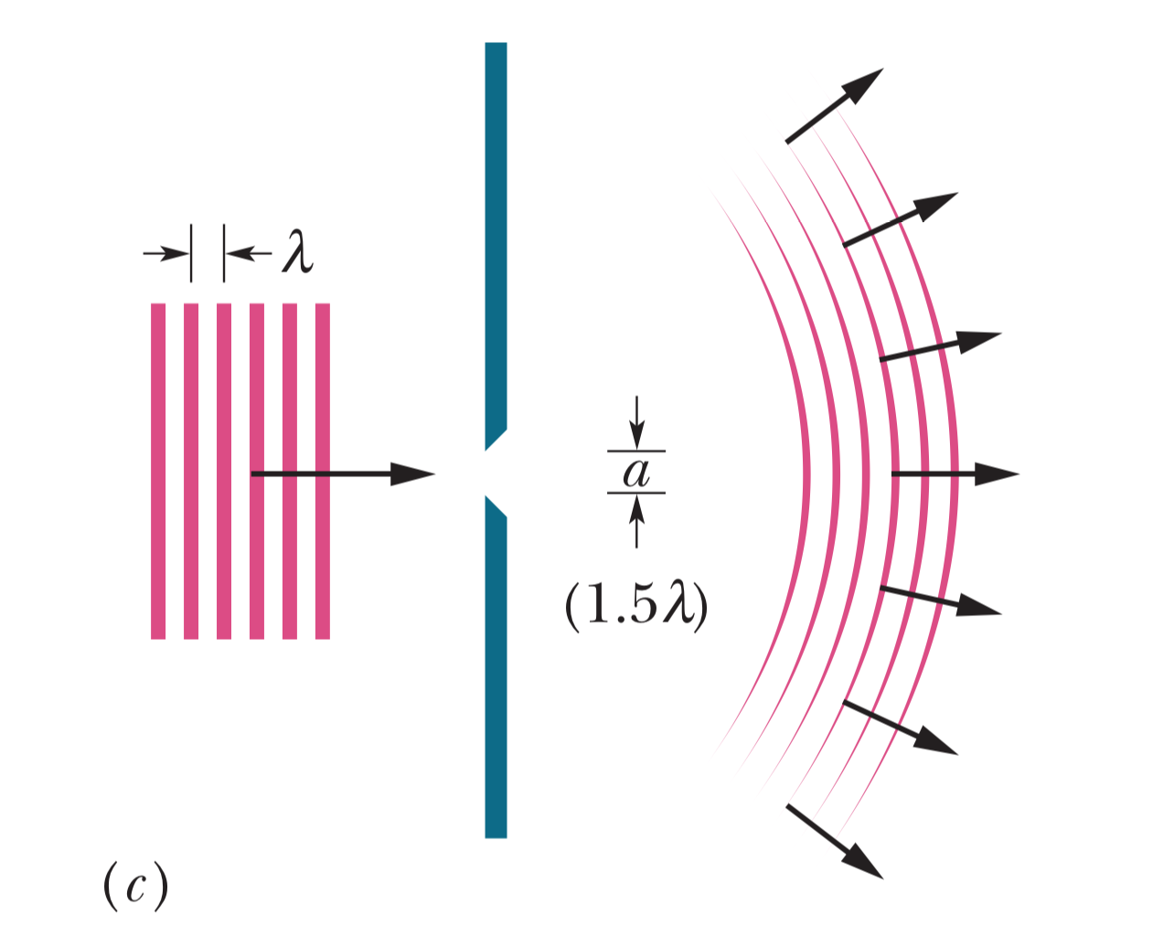
Diffraction of light (3)
Diffraction even greater with narrower slit

Slide 5
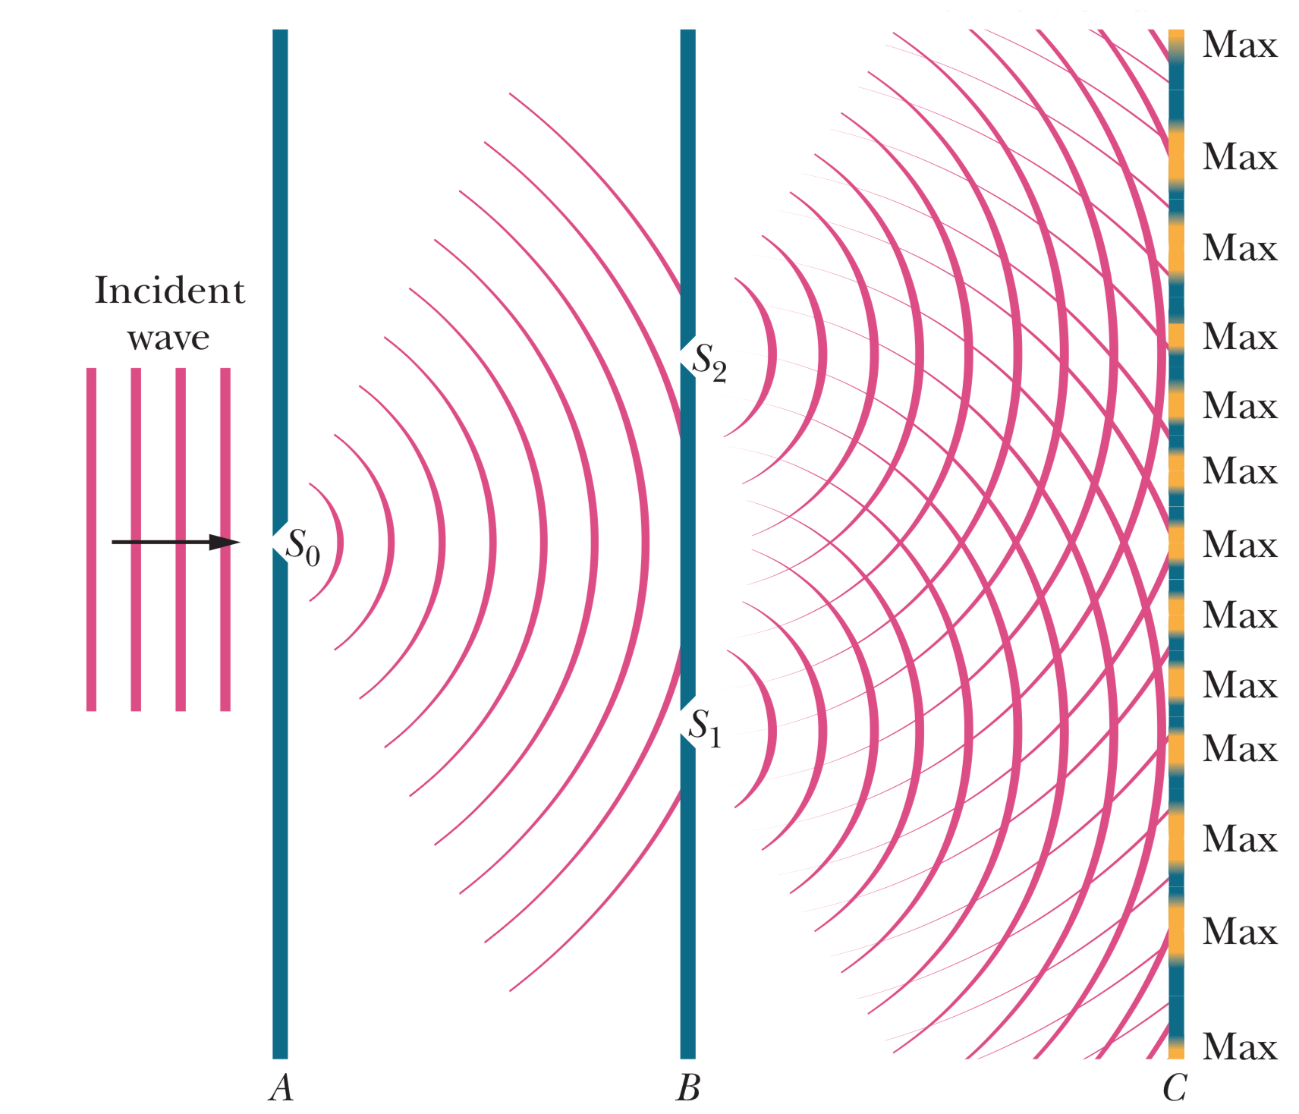
Young’s interference experiment

Slide 6
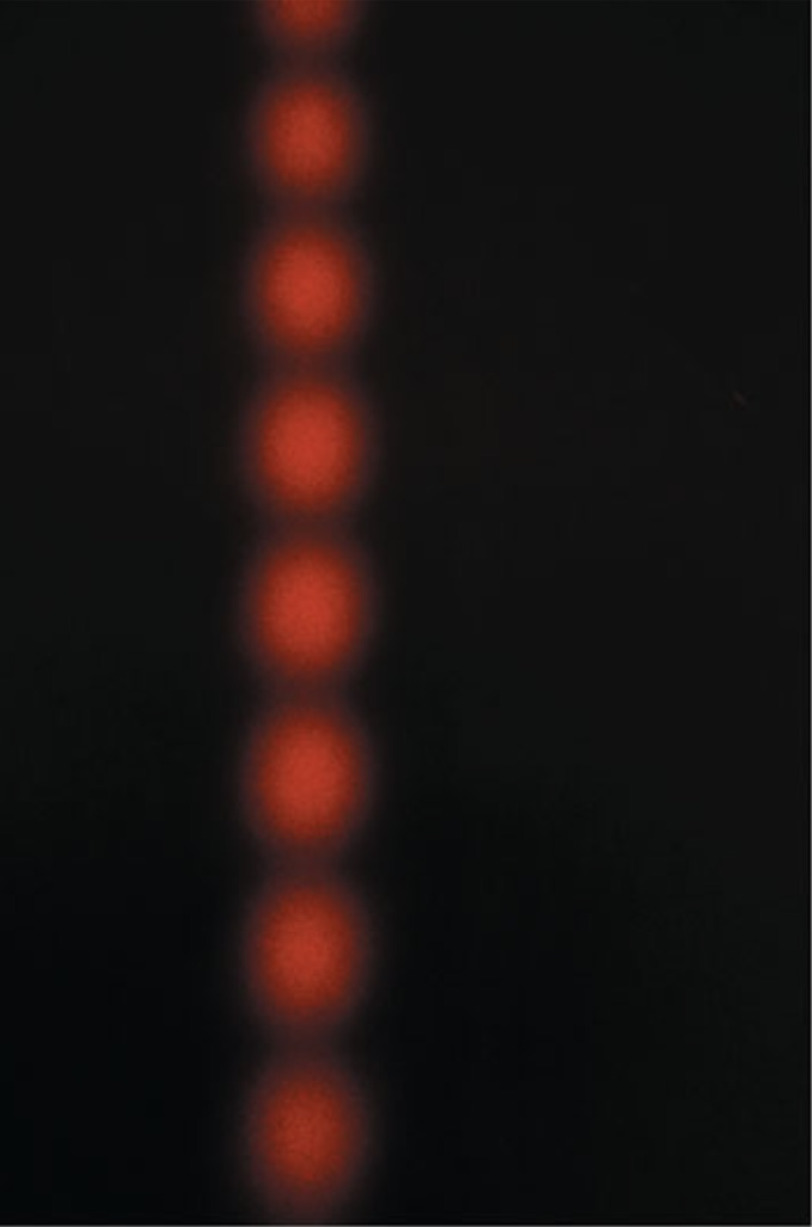
Inteference pattern from slit experiment

Slide 7
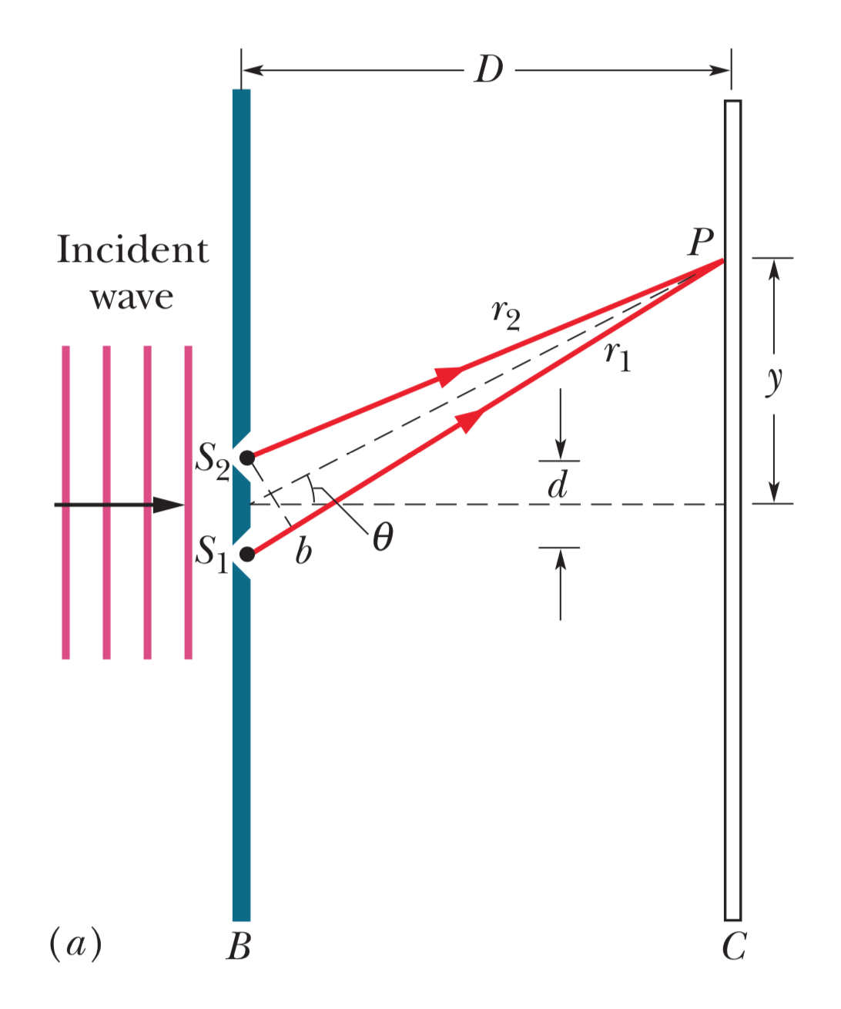
Locating bright and dark fringes

Slide 8
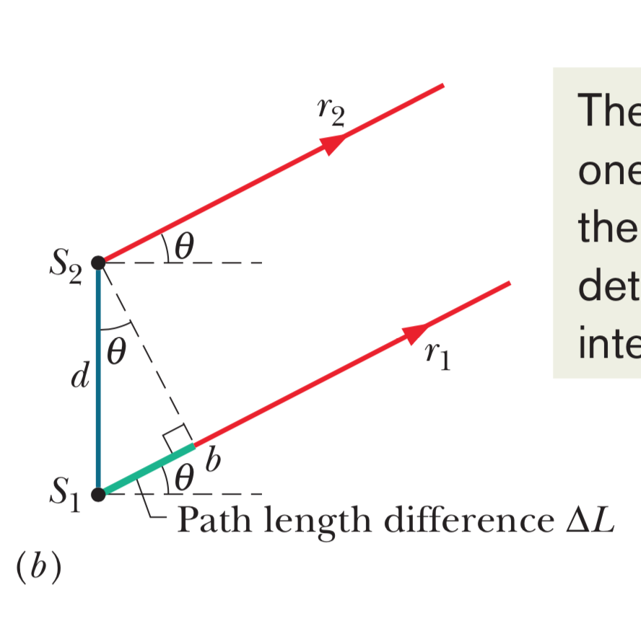
Approximation for locating fringes

